Slide 1
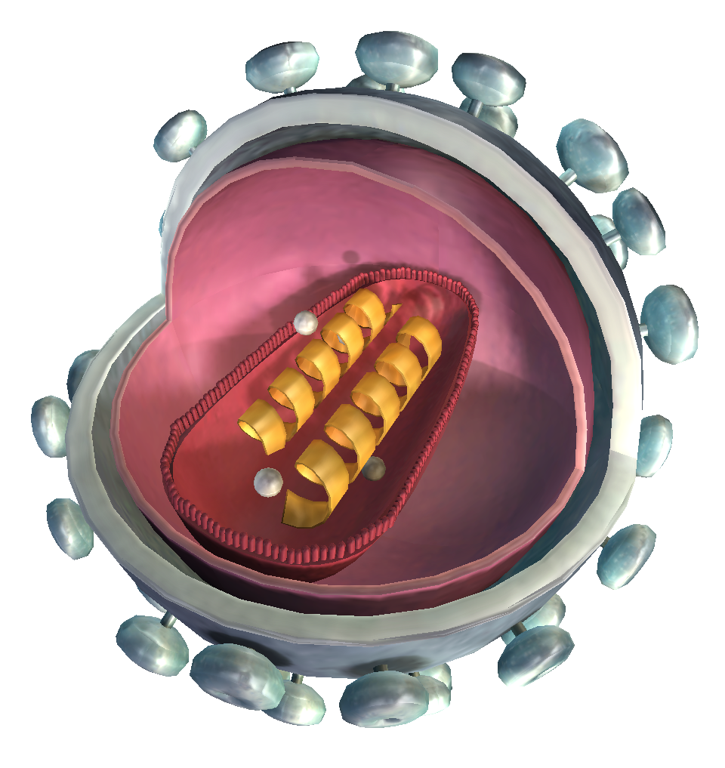


Duration: 95 min
Middle School
Grade: 6 - 8
CCSS, NGSS
What is a virus?
Life Science, Human Biology
Click to open in Lifeliqe

Slide 2

Lesson overview
Nobody's quite sure if we can label viruses as “living”. Many scientists struggle with this question. What we do know is that they are small, smaller than a single cell. They can be defined as a collection of a few molecules of genetic material, nucleic acid covered by a layer of protein mass to shelter themselves. They cannot survive for a long by themselves, therefore they need a host on whom they can “parasite”. However, this coexistence is only beneficial for the virus, as it takes over its host and forces him to do his bidding by overwriting its genetic material with its own. Cells become a “manufactory” and creates many copies of the original virus, which then inflict other ones and continue until the immune system or drugs slows them down or stops them.
Learning objectives
Find out what a virus is.
Compare the structure of a bacteria and a virus, find out the differences and similarities. Define the process of the virus infecting the living cell.
Keywords
HIV virus, Influenza, Bacteria, Infection

Slide 3
Standards
Common Core
CCSS ELA-Literacy
Conduct short research projects to answer the questions (including a self-generated question), drawing on several sources and generating additional related, focused questions that allow for multiple avenues of exploration.
WHST.6-8.7
SL.8.5
Integrate multimedia and visual displays into presentations to clarify information, strengthen claims and evidence, and add interest.
NGSS
MS-LS1-1.
Conduct an investigation to provide evidence that living things are made of cells; either one cell or many different numbers and types of cells.
MS-LS1-2.
Develop and use a model to describe the function of a cell as a whole and the ways parts of cells contribute to the function.

Slide 4
1. Activity – How I imagine a virus
15
min
At the beginning of the class, engage your students in a discussion about what they think a virus looks like and what it should have. Let them use their imagination and draw what they think a virus looks like. Give them several minutes and then ask some students to present in front of the class and introduce their virus. Encourage them to think of the virus as alone – what abilities do they need to survive and thrive. Ask what their viruses contain and why (e.g. my virus has a membrane to protect itself, it has a “brain” where its information is hidden etc.).
Follow this exercise with the following discussion questions.
2. Discussion – Virus, a mortal enemy
15
min
Question your students what they know about viruses and what their opinions are:
What is a virus? Do you think a virus is a living creature? Where can we find viruses?
Is a virus harmful or beneficial for us? Who can become infected? How does a virus differ from a bacterium? What are the similarities? How can we prevent a virus from infecting us?
Do you know some common vaccinations to certain diseases caused by viruses?
Modify the questions to suit you better or invent your own.

Slide 5
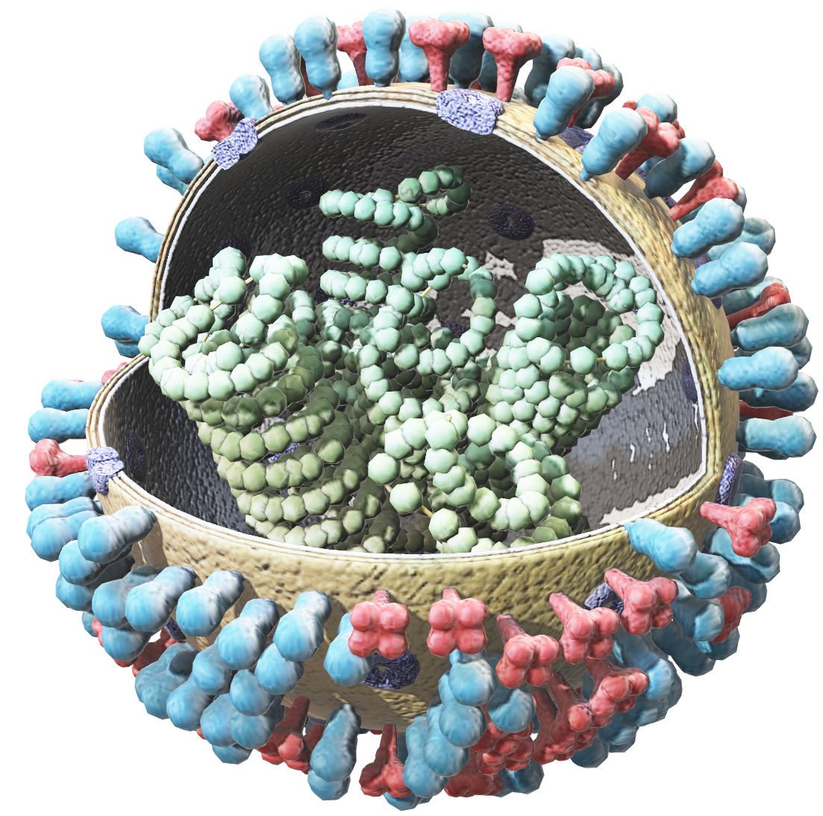
3. Topic – What is a virus?
10
min
Open the Lifeliqe “Influenza” model, located in Human Biology library. Provide brief information about Influenza (why is it harmful, what are the symptoms, their treatment, spreading of the virus etc.). Highlight individual parts of the Influenza virus and align the knowledge to the parts which were used by your students, for example:
“RNA is a source of information, a genetic material, which sends information towards the host cell to exploit it and reproduce within it, thus creating more of its copies. These copies do this same process again and again, growing in numbers numerously. RNA can be therefore interpreted as a “brain” or “information carrier” like in David’s virus, which had one. On the other hand, Hemagglutinin acts as connectors that attach to a host cell just like those spikes in Elisabeth’s virus.”
When you finish with your comparative explanation, ask your students to sum up what they learnt about Virus, what they know (and what they can deduce) and let them write it on a paper. It should look like:
Viruses are tiny particles that can infect not only humans, but also plants and animals and cause them a disease. Viruses are created of a genetic material RNa, which is protected by a protein wrapping. Viruses abduct specific cells of living organisms. Their insert their genetic information into the cell, overwrite it and take control. Cell becomes an unwilling host, which is forced to make more viruses and spread them to infect them further. As more and more cells are infected, the immune system starts to tackle them and signs of health issues occur. With the Flu, it can be sneezing, headache, raised temperature.
Click on the model to interact

Slide 6
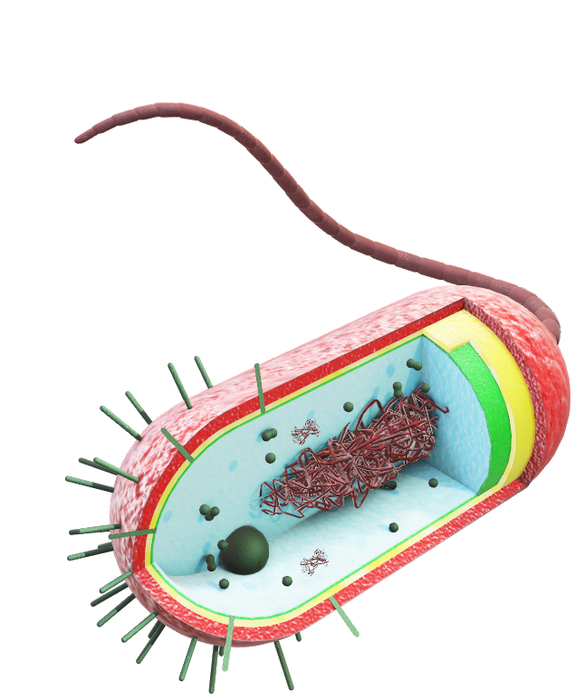
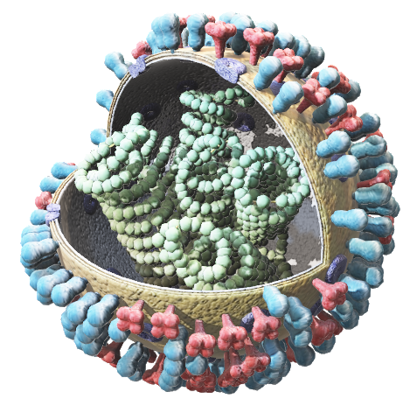
4. Activity – Bacteria and Virus are not the same
25
min
Tools
Device with LifeLiqe – “Bacteria” and “Influenza” 3D model, Internet connection.
Preparation
Make a following table in Word (Microsoft) or Pages (iOS), or copy it by using snipping tool.
Print them and hand out to your students before the activity.
Instructions
Work with Lifeliqe “Bacteria” 3D model, Lifeliqe “Influenza” 3D model and the Internet to find out the answers and fill the table. Encourage your students to find reliable sources and compare their information to find out if they differ or have same interpretation.
Work together with your students. Fill in the rows after you confirm the information provided you by the students.
Note: Some rows, such as Is it alive? or Treatment might have a variety of interpretations. They may result in discussion which encourage your students to brainstorm.
Extend your knowledge
You can extend the knowledge by watching a video about bacteria and viruses
on YouTube: https://youtu.be/s-HThHRV4uo
 | Bacteria | Virus
Introduction
Nucleus
Ribosomes
Nucleus
Structures (DNA or RNA position)
Reproduction
Treatment
Benefits
Size
Is it alive?
Click on the model to interact

Slide 7
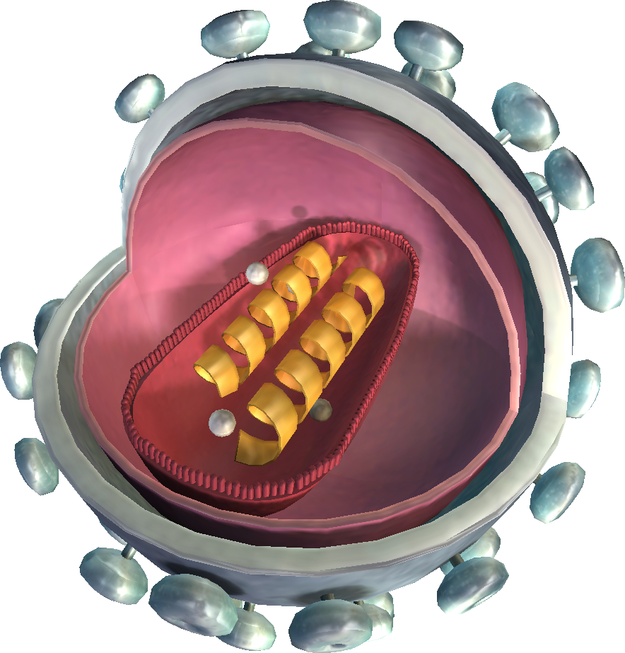
5. Activity – Evil scientist’s council
15
min
Tools
Device with LifeLiqe – “HIV virus” 3D model, Internet connection.
Instructions
Open Lifeliqe “HIV virus” model and show it to the class. If you have a tablet, use it as your “picture” through role play of an evil scientist. Talk about HIV as your virus which will rule the world, structuring text on the ideas from the bulletins in a following point. It should look like:
Glad to see everyone on the evil council. I present to you my HIV virus. Its symptoms diversifies from person to person, but mostly in the first stage people become acutely ill, having flu-like symptoms (fever, sore throat, headaches). However, the virus cannot be destroyed, even if the first acute illnesses diminish. It prevails silently in the second stage making its host look healthy and then, in the last stage, virus unleashes a full attack, destroying the victim’s immune system. From now on, it keeps victim’s defense very weak so even the ordinary curable illnesses can become a serious threat, even fatal. The Infected host then becomes a medium to transfer the virus through sexual intercourse, sharing injections when taking drugs or even through blood transfusions. People with a weaker immune system are more likely to get it. There is no cure for it yet, but many supportive treatments can cause it to rapidly slow down the evolution process and keep its host relatively healthy and long-living. Pretty evil, don’t you think?
Click to open in Lifeliqe

Slide 8
Form groups (or let students work alone). Ask your students to do the similar presentation as you. Let them look up on the Internet any interesting virus and after a while ask them to provide you the name of the virus they will present (done to eliminate duplicates of the same virus in presentation). Once all the viruses have been chosen, ask the students to provide the following information (you can modify them to suit your better)that they will use to make their presentation:
Name of a virus. Symptoms.
How can it be treated (if at all). How does is spread.
Deadly or not? To whom can it be? Who is more likely to get infected? What kills the virus (if it can be killed).
The explanation process should be kind of ‘scary’, making your virus sound terrifying and dangerous (with acceptable boundaries), just like the example in the previous point about the HIV virus. Use pictures from internet or your drawings of the virus for your presentation.
After all groups (or students) have presented, take a vote for which virus you will use to take over the world. Ask the students to give reasons why they think that the virus they have chosen is the best one.
Award the group (or student) whose virus won with the title of “The most evil scientist of the council”. You can even make a badge as a prize.

Slide 9

6. Activity – How do they transfer?
15
min
Tools
Plastic cups based on the amount of students (even number), distilled water, disposable pipette or eye-dropper with phenolphthalein solution, 1 teaspoon of sodium carbonate (=washing soda).
Note: For this exercise is required even numbers of students. If you have odd number, join the activity too.
Preparation
Prepare before class cups with water with the same amount.
Put down to random two cups a scant spoon of sodium carbonate and mix it properly so dissolve it.
Instructions
Have the students form a circle. Give each student a plastic cup with water in it. Every cup is numbered, therefore every student will represent the number on the cup they received. This is important as you will derive students to odd and even ones.
Every student should exchange the cup’s content with their classmates. Student pours all of the water from his/her cup into the classmate's cup. As the water mixes, the student with the full cup will pour half of the contents back into the first students cup. Students will exchange their cup’s contents in this order:
Odd numbered cups – exchange with the first classmate on your right (Student 1 with Student 2, Student 7 with Student 8 etc.).
Even numbered cups – exchange with the third classmate on your right (Student 2 with Student 5, Student 4 with Student 7 etc.).
Odd numbered cups – exchange with the third even number on your left (Student 7 with Student 2, Student 1 with Student 22 [when maximum amount of students is 26] etc.).
Select two random numbers (like 3 and 16 – maximum number = amount of students) and ask them to exchange the cup’s content. Repeat this process at least 2 more times.
Find out who is not infected and who is. Ask the students if they remember with whom they exchanged their fluids and if they can guess a specific source of the virus. Talk about how to prevent from getting a virus from someone or how to prevent from spreading a virus (coughing into a hand, sneezing into a tissue and not into a handkerchief, not touching used needles on streets etc.).

Slide 10
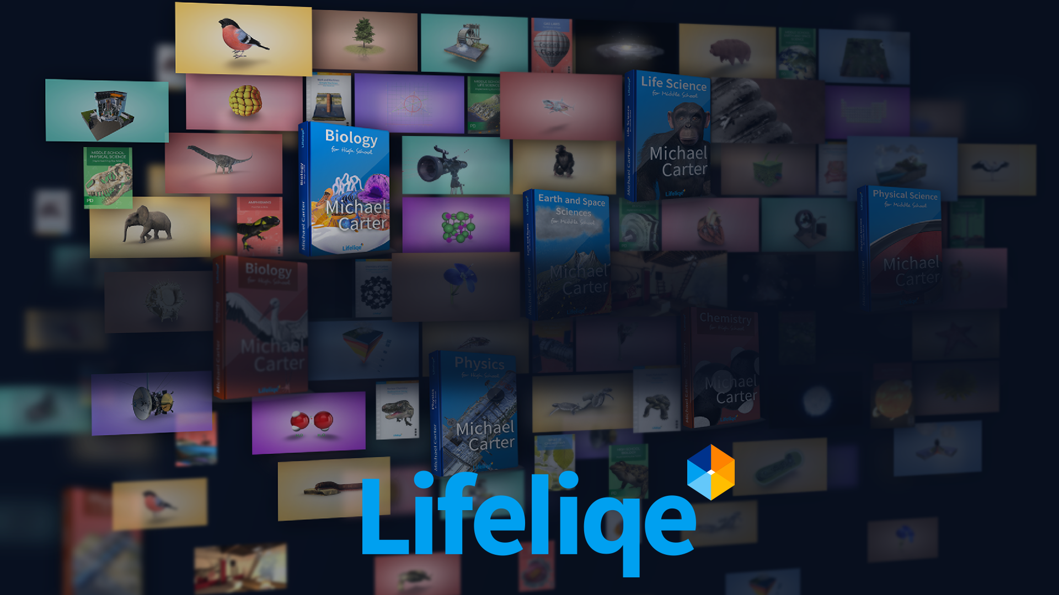
Thanks for using Lifeliqe's lesson plan!
Excite your students in learning science with 1,000+ more 3D models and lesson plans at online.lifeliqe.com

